Slide 1


Slide 2
2021
The Year for Resilience
Perseverance
to continue ………….
Developing Potential

Slide 3

The mission of Developing Potential is to provide quality day services to people having developmental disabilities and support those individuals to reach their fullest potential.
Notes:
Why DPI was started

Slide 4
Demographic Data
Ethnicity
Living Arrangement
African 18 % American~Caucasion~74%
Asian~3%
Hispanic~3%
Other~2 %
Natural Home~65%
Residential Program~32%
Lives Independently~3%
Age Range
Gender
20 to 35~49%
36 to 45~21%
46 to 55~17%
Over 55~13%
Male~55%
Female~45%

Slide 5
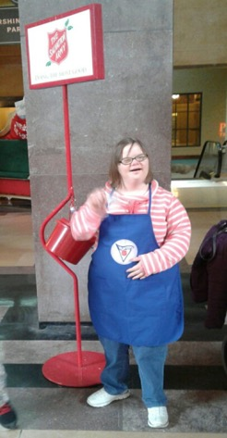
DPI Services
  Day Services since 1993
  Kansas City~1993
  Independence~2002
  Lee’s Summit ~2012
Employment Connections Division since 2012

Slide 6
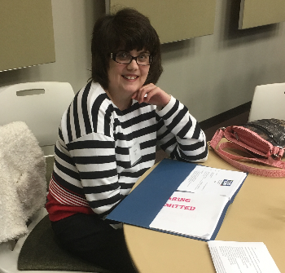
DPI Employment Connections
DPI Employment Connections seeks employment opportunities uniquely suited to each person’s interest, abilities, and goals. The process is person-centered and seeks to integrate all of the factors that determine job satisfaction.
Number of people served: 38
Notes:
Currently:
17 people in the program; 17 job placements; 2 people hold 2 jobs each
People have had jobs at 30 places since 2012
Amanda West—Summit Pet care—Nov 12 to current
Ben Baldwin—Taco Bell—May 2013-current
Danny Midkiff—Chili’s May 2014-current
John Wedgworth—Olive Garden June 2014-current
Danny Midkiff—Habenero’s Aug 2014-current
Austin Dearth—Pizzabella Nov 2014-current
Shannon Stevenson—Salon Ami April 2015-current
Matt Water—Tuesday Morning April 2015 to current
Shawna Knutter—KFC—May 2015-current
Anthony Wascher—Velocity—July 2016-current
Andrew Brown—Bed Bath and Beyond—Sept 2016-current
Leonda Day—Laura’s Cleaning 4 U—Oct 2016-current
Collin Jarrett—Wendy’s Dec 2016-current
John Wedgeworth—Steak N Shake—Jan 2017-current
Chris Day—Weed Man—March 2017
Charles Sharifi—Dollar Tree—March 2017-current
Sarah Hill—Wendy’s—April 2017-current

Slide 7
DPI Employment Connections Places of Employment in 2021
Summit Pet Care
Taco Bell
Chili’s
Olive Garden
Habenero’s
Pizzabella
Salon Ami
Tuesday Morning
KFC
Velocity
Bed Bath and Beyond
Laura’s Cleaning 4 U
Wendy’s
Steak N Shake
Weed Man
Dollar Tree
Notes:
Kari please add

Slide 8
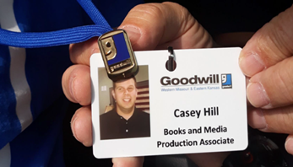
The Mission of DPI Employment Connections
DPI Employment Connection’s mission is to seek meaningful employment for those with the desire to work.
Vision Statement: DPI Employment Connections is to seek employment opportunities uniquely suited to each person’s interest, abilities, and goals.

Slide 9
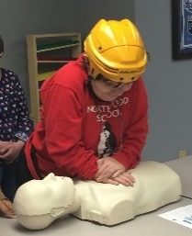
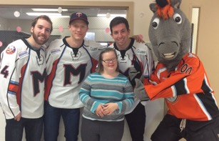
Day Services
DPI provides individualized services to adults having developmental disabilities at our three area locations:
1608A Prospect Avenue Kansas City, Missouri
120 West Walnut, Independence, Missouri
251 NW Executive Way, Lee’s Summit, Missouri
Number of people served in 2021- 150 average through connections and pivoting services as needed during a pandemic.
June to December 2021 on site Day Services
Kansas City: 23
Independence: 25
Lee’s Summit: 24

Slide 10
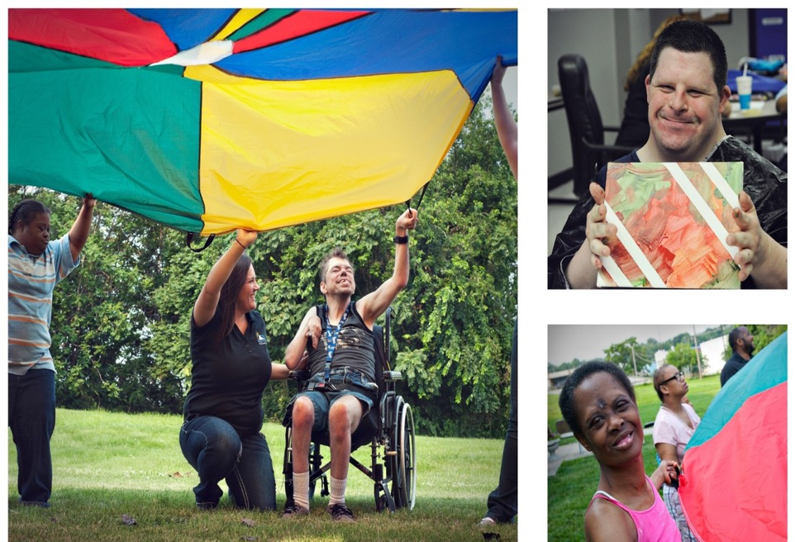
Creating friendships - meaningful experiences

Slide 11
Accreditation and Honors
DPI holds 8 successful three-year CARF accreditations.
DPI was honored twice by CARF for exemplary performance in advocacy and program planning
DPI was honored to receive the eitas Innovation/Excellence in Service and Support in April 2009, and a Certificate of Achievement in April 2012.
DPI was proud to add Employment accreditation to our Day Services Accreditation with CARF in 2019.
DPI was honored to be elected non for profit of the year in 2019 by the Lee’s Summit Chamber of Commerce.

Slide 12
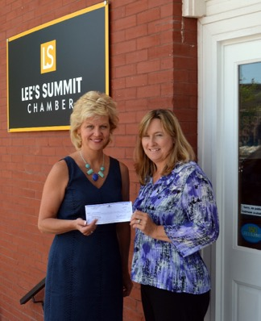
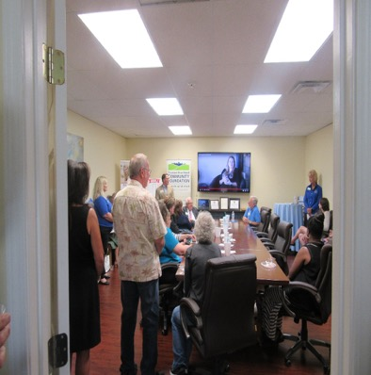
Community Support - Kindness

Slide 13
Here are a few comments from our latest CARF survey report…
‘Staff members are very involved in creating person-centered connections and developing excellent rapport with individuals served.’
‘The staffs nurturing relationships and active engagement with individuals served also enhance the success of DPI’s programs’.
‘DPI is commended for including individuals served in the activities of its various committees, such as Program Planning and Safety Committee’.
‘DPI employs a sound approach to quality improvement and growth.’
‘The level of detail in and comprehensiveness of many of DPI’s plans and data collection processes are quite remarkable for an organization of its size’.
‘DPI is well respected and praised by referral sources, individuals served, guardians/families, and other stakeholders’.

Slide 14
Financial Highlights 2021

Slide 15
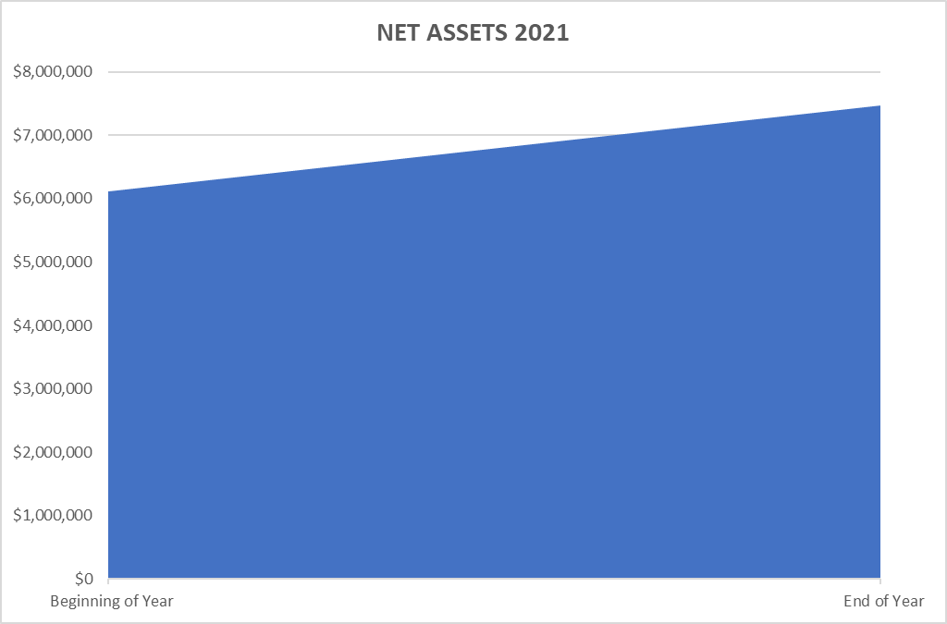
Sustainability through Challenging Times with Support

Slide 16
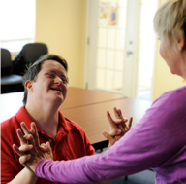
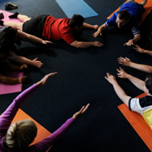
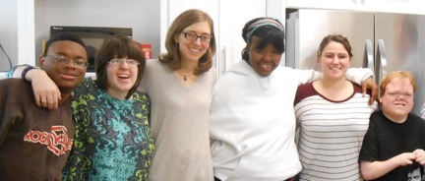
Programming Highlights and
Covid 19 Response
Telehealth
Support with Station MD
Covid Resources Sharing/information
Vaccine Information
Yoga with Leslie Patterson
Volunteering
Curriculum
Health and Wellness
Notes:
Kari to discuss programming- around the world; 50 states- current person of influence- poetry; OT assessments; Health Assessments by Nurse; communication and assistive technology ; community integration and volunteer sites

Slide 17
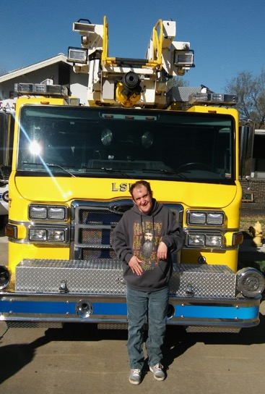
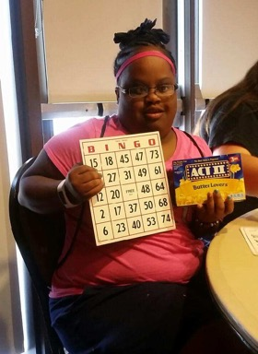
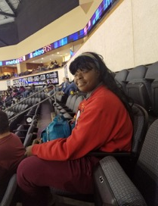
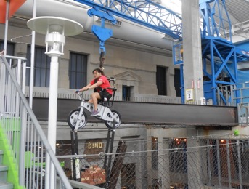
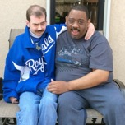
Community Involvement
Notes:
Add in DPI pictures – important to be engaged with our community and be a community citzen- voting, access recreational resources in our community such as parks, Union Station, Science Center, Sermon Center, the YMCA, Royals to name a few examples

Slide 18
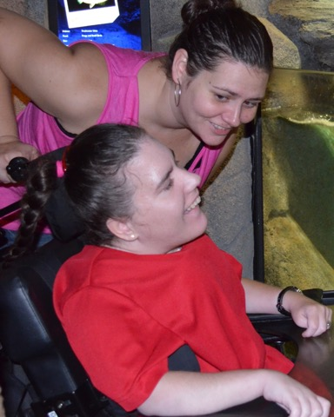
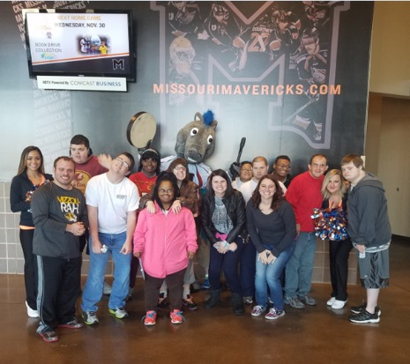
Culture of Gentleness
Notes:
Kari- Tell about training staff and a success story for someone at DPI with Gentle Teaching;

Slide 19
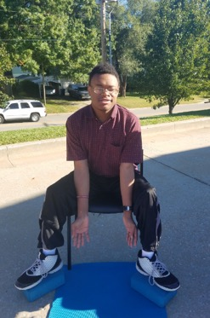
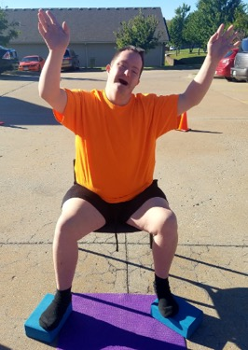
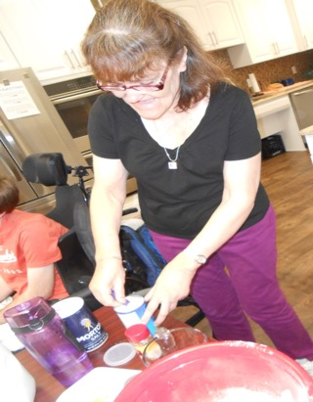
Increase Access to Service Program Model
Health and Wellness
Notes:
Kari’s part- Health and Wellness Educational classes; Health Assessments by the Nurse; Opportunities for execisitng on site and off site; enjoying modified yoga classes,

Slide 20

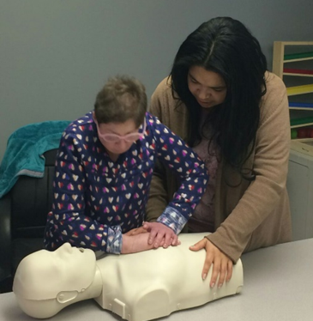
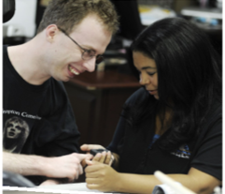
Notes:
Staffing Challenges- Our model is intensives daily self care help support therefore finding staff to assist with all aspects of self care needs can be a challenge; We take seriously the role of finding and retaining quality staff; we seek to ensure our staff feel valued, affirmed and provide fun staff retention activities through the year such as>>>>>>

Slide 21
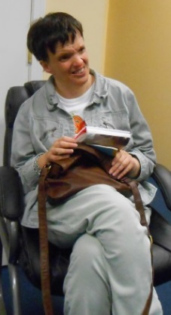
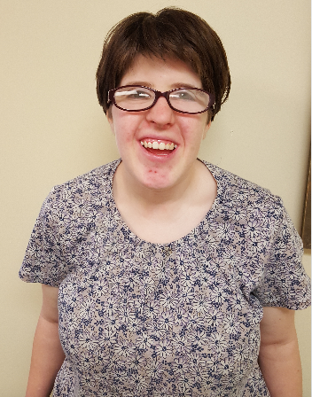
Through Holistic Programming, personal success comes in many ways.
Meet Nancy
Meet Mary Kate
Notes:
Share success story with Gayle working with Nancy and how she has a wonderful bond rappor that reduced anxiety which lead to Nancy feeling more comfortable with taking the Yoga Classes, At a recent March 2017 Parent meeting, the mother share a success story about Nancy’s swim coach amazement in picking up an additional skill of kicking while doing laps in the pool at her regular Sunday classes, Nancy had been doing swim classes for years but not successful in the leg kick movement; recently she has been kicking and helping her arms with the movement across the pool. The Yoga Insctgurtor lisle has been working on leg strengthing.

Slide 22
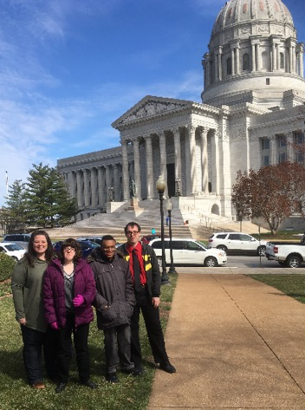
DPI seeks to ensure Missouri Quality Outcomes
MQO#14~People are supported to attain physical health and wellness
  People are safer by raising awareness of his/her own fall risks
  Staff are trained in fall risks
  Yoga offered at all locations
MQO#1~People belong to their community
  People have the opportunity to be in the community
  People will venture to new places
  People will have opportunity to participate in community presentations

Slide 24
Thank You
Thank you to Country Club Bank for their support in ensuring DPI could access the Federal Paycheck Protection Program to ensure all staff received ongoing pay and support during the three month closure for onsite programming.
Thank you to Jackson County Board of Services for their ongoing support with DPI’s pivoting during the closure months to ensure telehealth and resource/connections for persons served in our DPI Employment Connections Program and DPI Day Services program. Your ongoing support was invaluable.
Thank you to Department of Mental Health for the ongoing trainings regarding the public health emergency and resources provided through communication and training to ensure persons in our community has support needed.
A big shout out to our community residential providers for their hard work, dedication during a challenging year.
AND To our DPI Staff that has worked hard to follow Covid Procedures, donned PPE and keep everyone safe- YOU ARE AMAZING!

Slide 25

Notes:
DPI believes in finding the right staff who have a heart, having a mission that is reflective of a gentle heart -

Slide 26
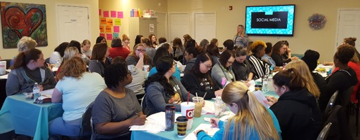
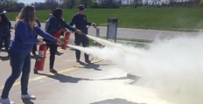
Staff
Trainings
Back Injury Prevention
Bloodborne Pathogens
Seizure Recognition
First Aid/CPR
Medication Administration
Gentle Teaching
Range of Motion
Mobility
Keller Fire Extinguisher Use
Covid 19
Adaptive Equipment
Cultural Competency/Diversity
Abuse/Neglect
Team Building
Sensitivity
Defensive Driving
Documentation
Community Safety
Effective Communication

Slide 27
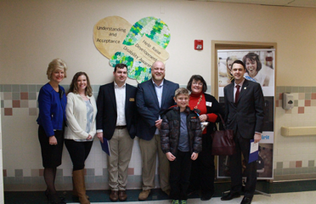
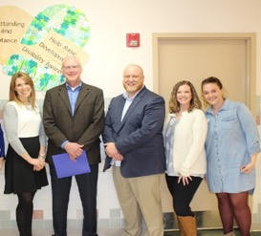
DPI’s Advocacy
DPI advocates on behalf of the individuals we serve by engaging our state and local legislators, keeping informed on national trends and sharing our advocacy efforts with our families.
Advocacy engagement at DPI includes inviting legislators to DPI for tours, supporting the annual APO Legislative Breakfast in Kansas City, being an active member of MARF, attending Town Hall meetings, engaging our stakeholders in supporting Disability Rights Legislative Day in Jefferson City, and more.
Notes:
Amy

Slide 28




DPI’s Advocacy
In addition to DPI’s legislative advocacy, we are busy advocating for our individuals in our communities, too. Even during Covid, DPI through telehealth worked to connect with Community Leaders. Community advocates are invited to learn about our services, and discuss ways in which they can be engaged in the services we provide in the community.
DPI is always looking for ways to help our supporters introduce us to others in the community. We engage the community socially through out Facebook, Twitter, Instagram and LinkedIn social marketing.

Slide 29
Strategic Planning-Being Responsive
National trends articulated by CMS and illuminated through funding and legal actions about meaningful day activities and employment- DPI is in the process of a Capital Campaign to support the building of new community center which will assist with having access to services in Eastern Jackson County. DPI made the Mabee Grant Challenge in 2020 and hopes to break ground in 2021.
DPI seek to ensure we have a well qualified workforce by seeking support through grants, cost of service fee needs for increase from the State of Missouri and works hard to ensure competitive pay and excellent benefits are offered.
DPI Foundations priorities for children not adult services and the educational issues in the KC School District where foundations priorities are focused due to the crisis
The needs and desires of individuals with developmental disabilities and their families

Slide 30
Goals for the Future
Continue choices/Individuals plans of care
Respond to Families needs
Compliance with HCBS Guidelines
Community Center Model to have opportunity for Health and Wellness Activities and meet
Funding from State and Grants to Support staffing needs
Making a difference in our community partnership – Strategic Planning to ensure programming needs to our families and persons served.

Slide 31
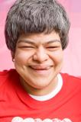
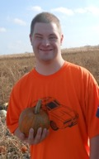
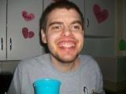
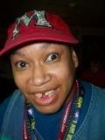
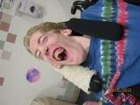
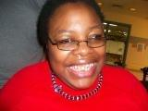
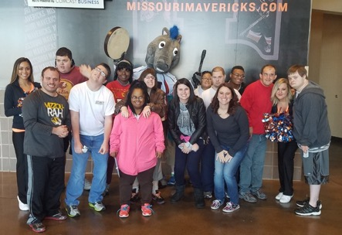
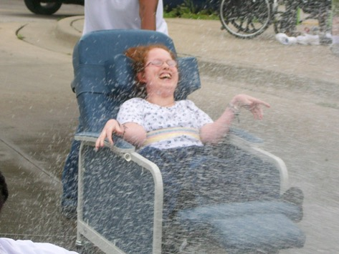
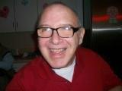
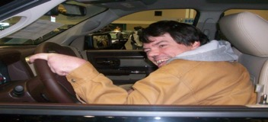
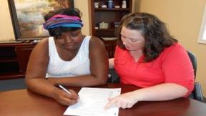
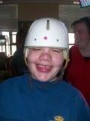
Notes:
So we leave you with the Faces of DPI that touch our heart, inspire our mission. Thank you for your partnership.

Slide 32
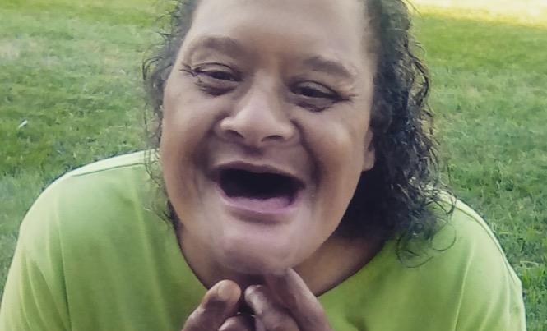
Developing Potential, Inc.
Mailing Address – 251 NW Executive Way, Suite 200
Lee’s Summit, Missouri 64050
816-525-6000, ext. 101
www.developingpotential.org

Slide 33

Thank you for your support
DPI is a not for profit 501 C Organization.
CARF accredited- since 1994
Funding provided by Department of Mental Health, State of Missouri
Funding provided by eitas- Jackson County Board of Services

